Slide 1


Capstone Project -2
Presented by: Pratiksha Mayekar
Date : 05/07/2021

Slide 2

Airbnb, operates an online marketplace for lodging, primarily homestays for vacation rentals, and tourism activities. It is based in San Francisco, California. The platform is accessible via website and mobile app. Airbnb does not own any of the listed properties, instead it profits by receiving commission from each booking. The company was founded in 2008 by Brian Chesky, Nathan Blecharczyk and Joe Gebbia. Airbnb is a shortened version of its original name, airbedandbreakfast.Com.

Slide 3

Data Source
https://www.kaggle.com/kritikseth/us-airbnb-open-data
This dataset provides the details of the listings for different kinds of accommodations across USA since 2008. It also lists all the hosts and the occupancy of each listing.
I chose this project to understand the trends of Airbnb in USA and analysis is done through addressing the following questions.
How does the prices for Airbnb rentals fluctuate over the years?
How much Airbnb grown over the period ?
Where to invest in a property in USA to get the maximum number of returns from Airbnb?
How well can we predict reviews and what aspects are correlated with the reviews?
How do prices of listings vary by location?

Slide 4
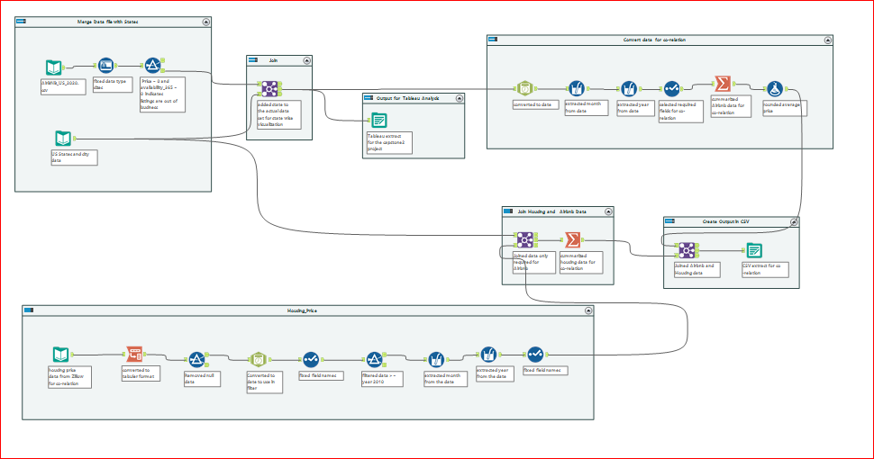
Alteryx Use for data cleansing

Slide 5
Correlation
https://www.zillow.com/research/data/
Try to correlation with House Price used Zillow.com for dataset.
A separate U.S. study found that a 1% increase in Airbnb listings leads to a 0.018% increase in rents and a 0.026% increase in house prices. It might not seem like much on the surface but there's a cost creep for those looking to rent long-term or buy

Slide 6
THANK YOU

